Slide 1


Transformer Capacity Sizing Electric Power Load Analysis (EPLA) Revision of 2 May 2026
Dr. Norbert Doerry
http://doerry.org/norbert/MarineElectricalPowerSystems/index.htm
© 2026 by Norbert Doerry This work is licensed via: CC BY 4.0 (https://creativecommons.org/)

Slide 2
Essential Questions
What is the procedure for determining transformer capacity? | Understand
What are the trade-offs with respect to using a single three-phase transformer and using three single-phase transformers | Understand
What options are available for addressing large transformer inrush current? | Understand
What other considerations are there for selecting the capacity of transformers? | Understand

Slide 3
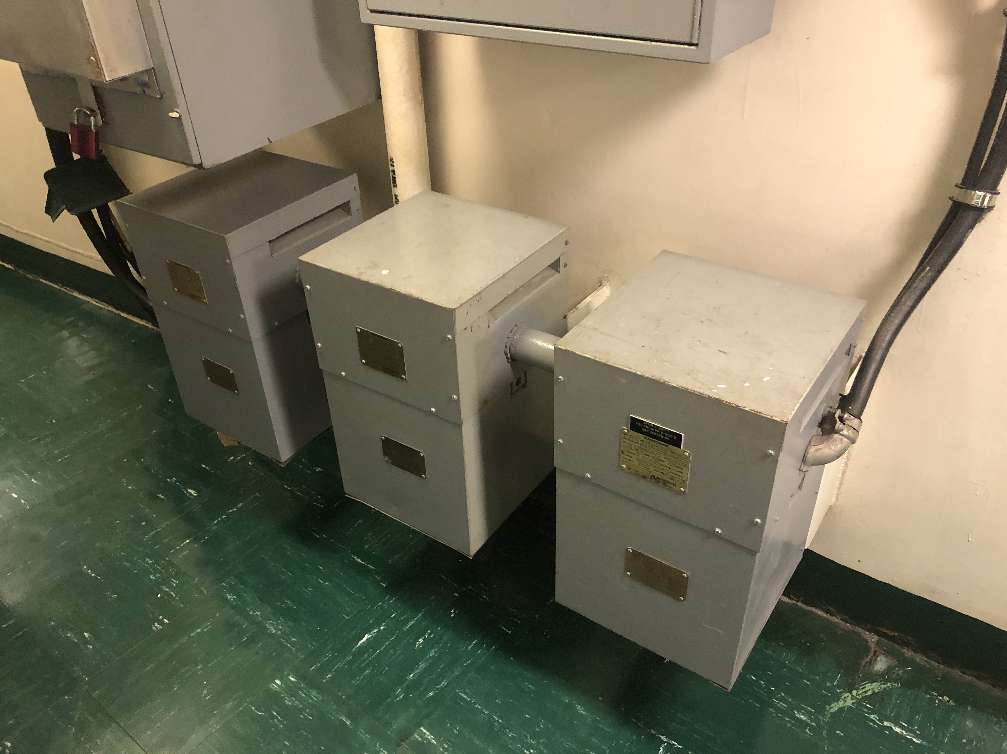
Introduction
Power transformers may be employed to connect two ac power systems the same frequency and potentially different voltages
Three phase power transformers may be composed of:
Three single phase transformers
One three-phase shell-type transformer
One three-phase core-type transformer
Sources of requirements and recommendations
46 CFR 111
ABS Rules for Building and Classing Marine Vessels
IEEE Std. 45.1, IEEE Recommended Practice for Electrical Installations on Shipboard - Design

Slide 4
Load analysis
Traditional load analysis
Assumes many loads where variation of the total load around the mean is small.
Usually applicable at the total ship level
Transformers usually only serve a subset of the total load
The variation of the total load around the mean is relatively larger
Extended periods of time in an overload may result in insulation damage within the transformer
Zonal load factor method (DPC 310-1)
Zonal load factors account for variability in the total load due to having non- constant power loads
Almost always results in a larger operating load as compared to the traditional load analysis
Reduces risk of overloading transformers

Slide 5
Margin and service life allowance
Margin accounts for uncertainty in the operating load estimate during design and construction
IEEE Std 45.1 recommendation
Detail Design Margin: 5% for existing follow-on designs to 20% for new first-time designs
Construction Margin: 5% for existing follow-on designs to 20% for new first-time designs
Service life allowance (SLA) accounts for growth in load while the ship is in-service
IEEE Std 45.1 recommendation
20% (1% per year for 20 years)

Slide 6
Harmonic and common mode currents
Harmonic and common mode currents create heat within the transformer
Currents do not contribute to useful work
Common mode currents of most concern if the transformer has a delta primary and a wye secondary with the neutral connected to ground via a neutral grounding resistor
Current through the neutral connection results in a circulating current in the primary windings
IEEE Std. 45.1 provides recommendations for derating transformers to account for additional heating

Slide 7
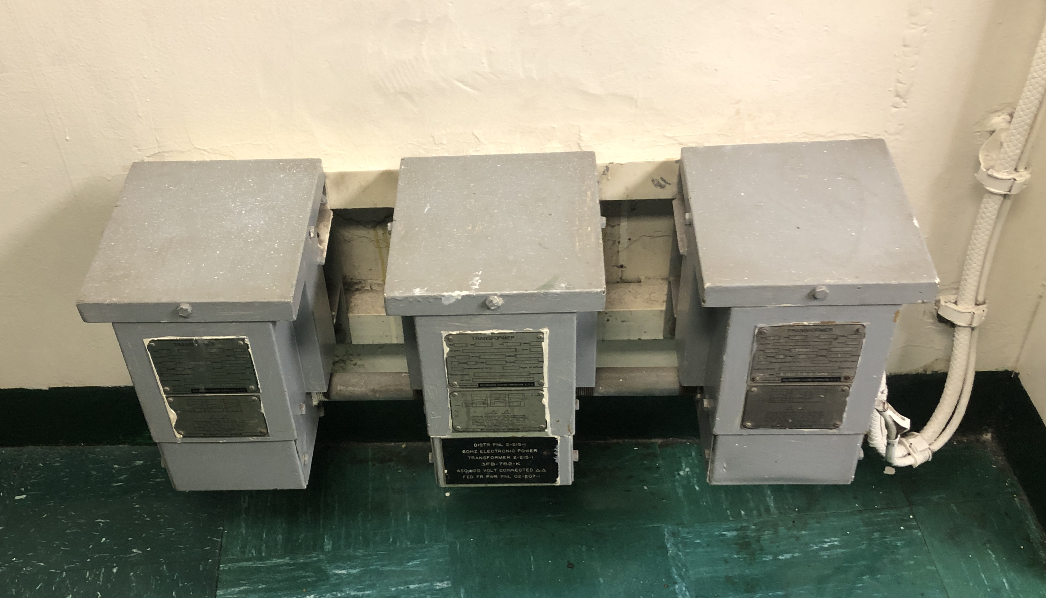
Survivability
Ratings of transformers should account for …
Normal operation
Additional load applied via bus transfers when other transformers not in service
May require load shedding
Delta-Delta transformers may be constructed from three single phase transformers
Enables continued operation with the removal of one transformer
Open delta configuration
Capacity drops to about 58% of the full three transformer rating

Slide 8
In-rush current
Large transformers may have a higher in-rush current than can be supplied by the generator sets
Options to address include:
Use of pre-charge circuitry
Replace one large transformer with multiple smaller transformers
Do not energize multiple transformers at the same time

Slide 9
Fault protection
Larger transformers have lower impedance
Ensures secondary voltage is not too low at full power
Low impedance results in higher fault currents on the secondary
May exceed interrupting capability of circuit breakers on the secondary distribution system
Possible solution
Replace one large transformer with multiple smaller transformers

Slide 10
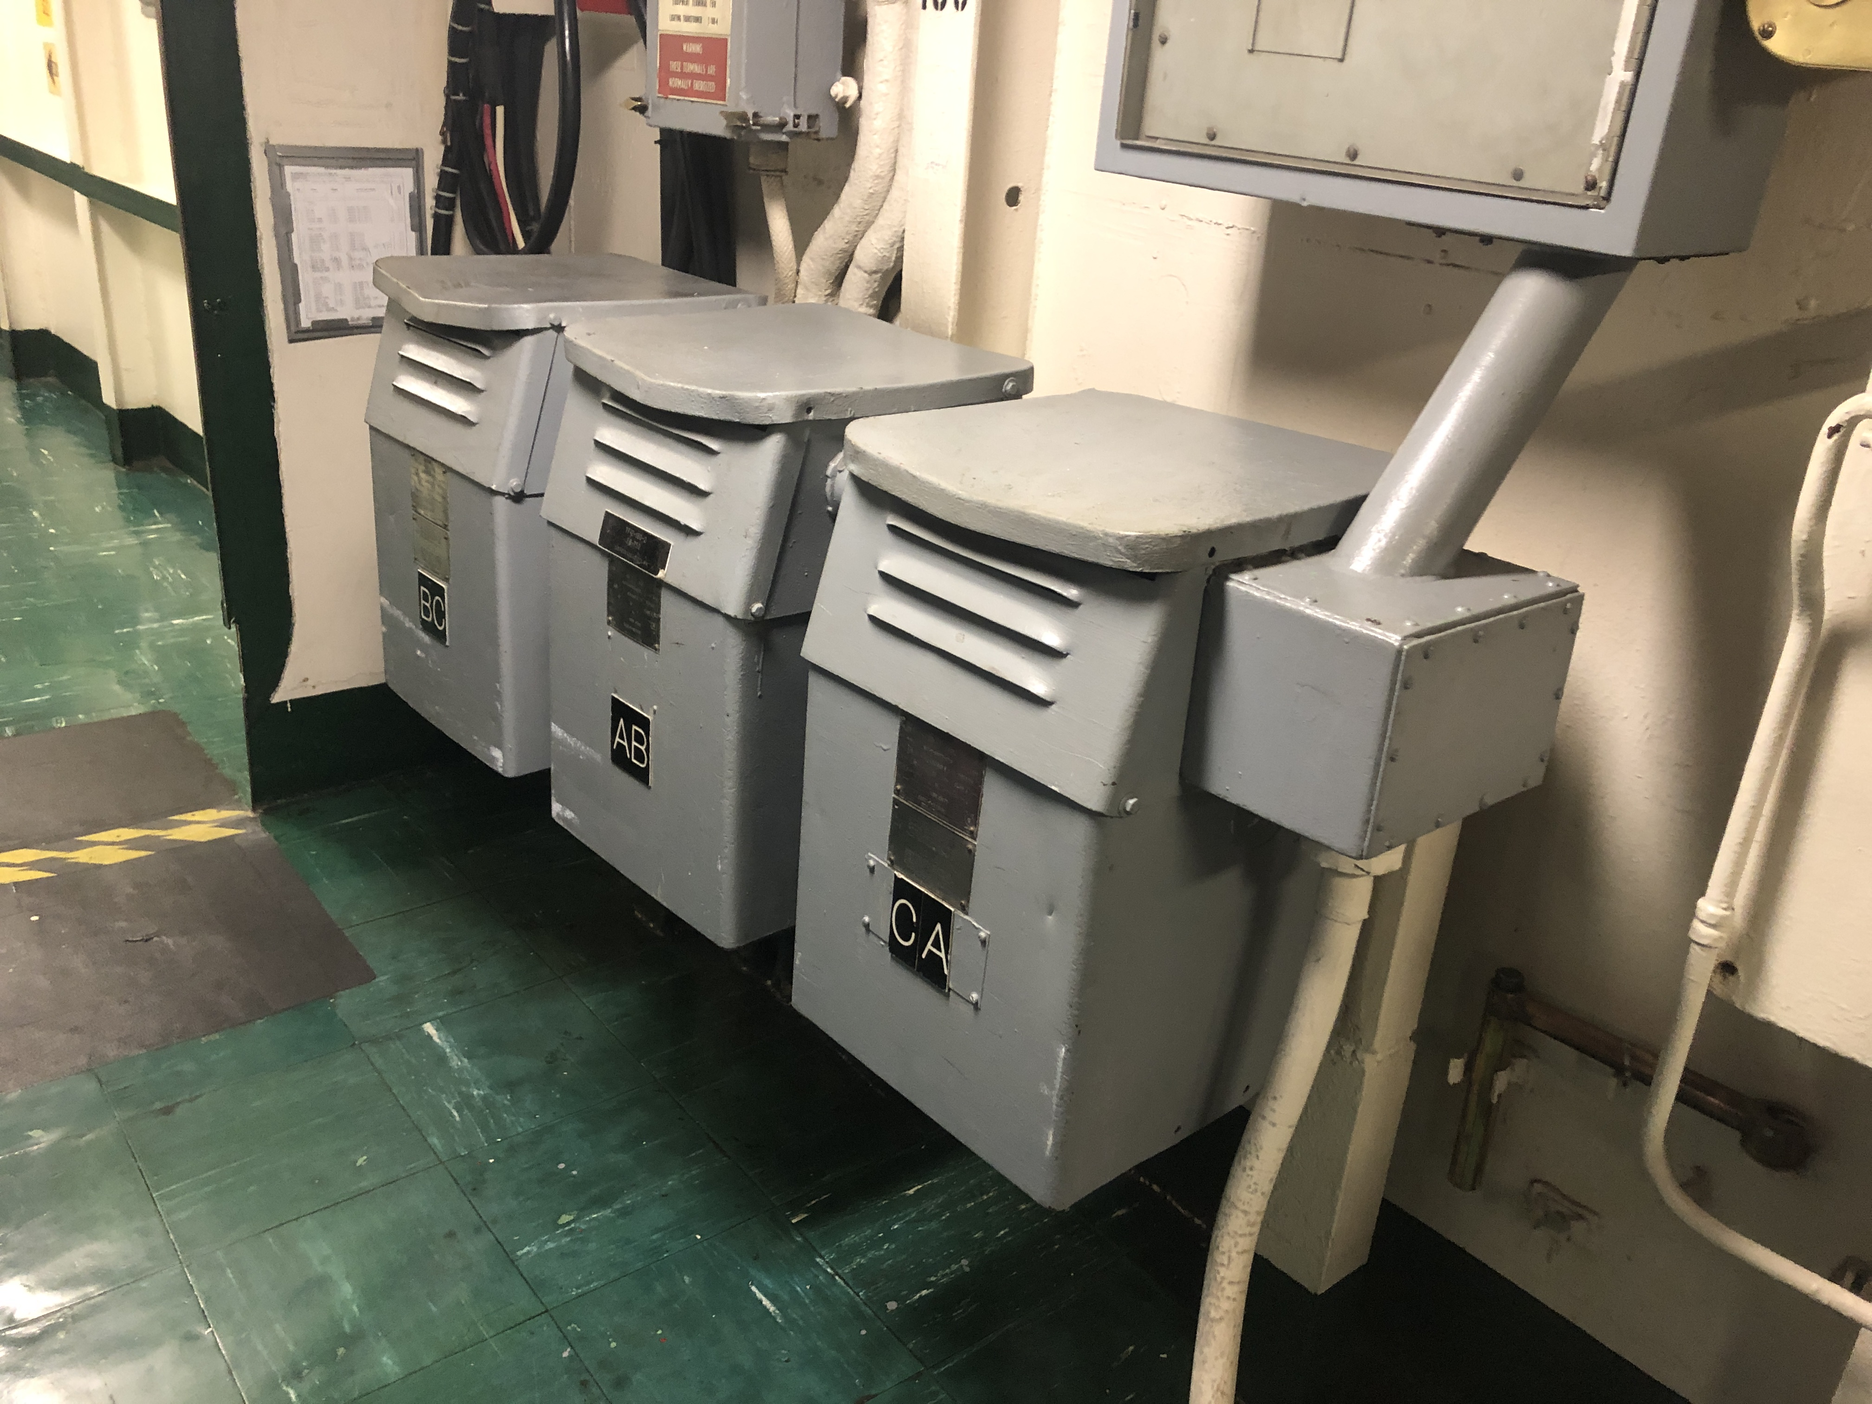
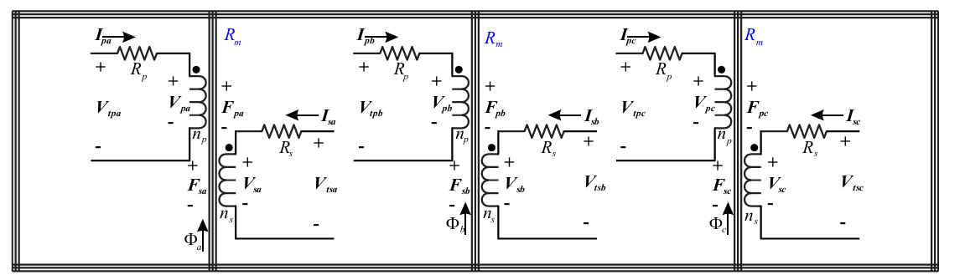
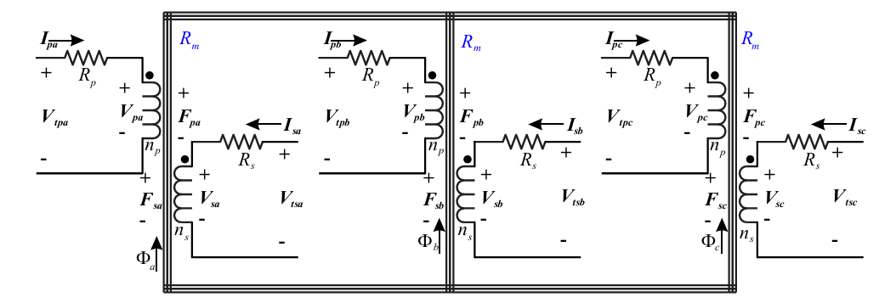
DC current saturation
If a transformer is a delta wye, with the neutral connected to ground via a neutral-grounding resistor ….
If the distribution system on the secondary feeds an un-isolated rectifier that suffers a ground fault on the dc side …
Then the transformer windings will experience a dc current component
A dc current component may result in transformer saturation if the transformer …
Is fabricated using multiple single phase transformers
Is fabricated using a shell-type transformer core
Transformers fabricated using a core-type transformer core are less susceptible to saturation from dc currents.

